Slide 1
Final Project: The Battle of Neighboorhood
Goal: choose a location in New York for a sit down restaurant
Target Customers: average income
Preference: larger population and higher GDP area

Slide 2
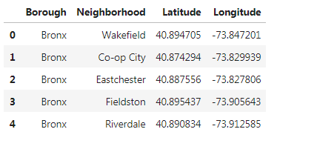
New York Neighborhood Location Data
Source: https://cocl.us/new_york_dataset/newyork_data.json

Slide 3
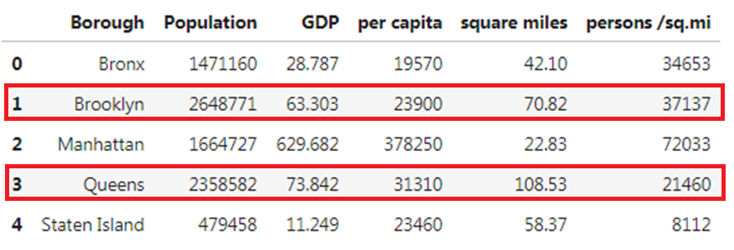
Population & Capita Dataset
Narrow down our option to 2 boroughs: Brooklyn and Queens
source from: https://en.wikipedia.org/wiki/Boroughs_of_New_York_City

Slide 4
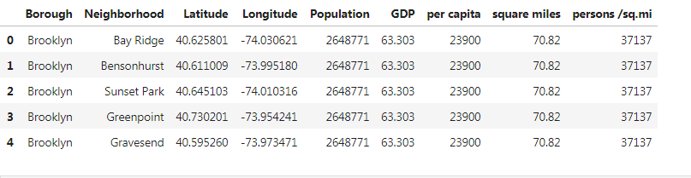
Merge 2 Sets of Data for Brooklyn and Queens

Slide 5
Use FourSquare to get the neighborhoods, current restaurants map for both Brooklyn and Queens

Slide 6
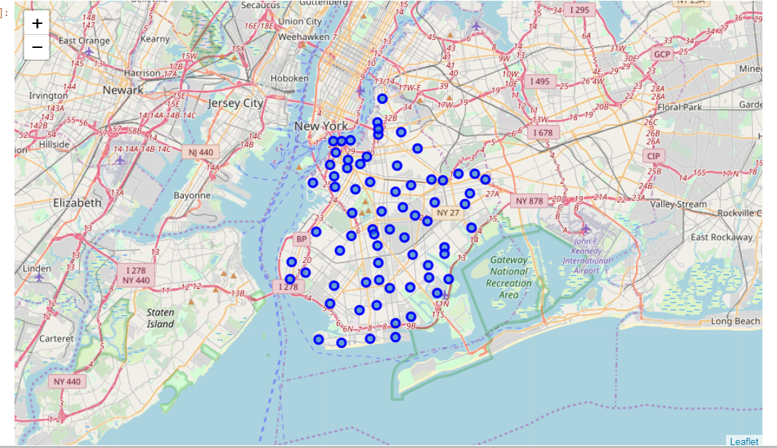
Brooklyn Neighborhoods

Slide 7
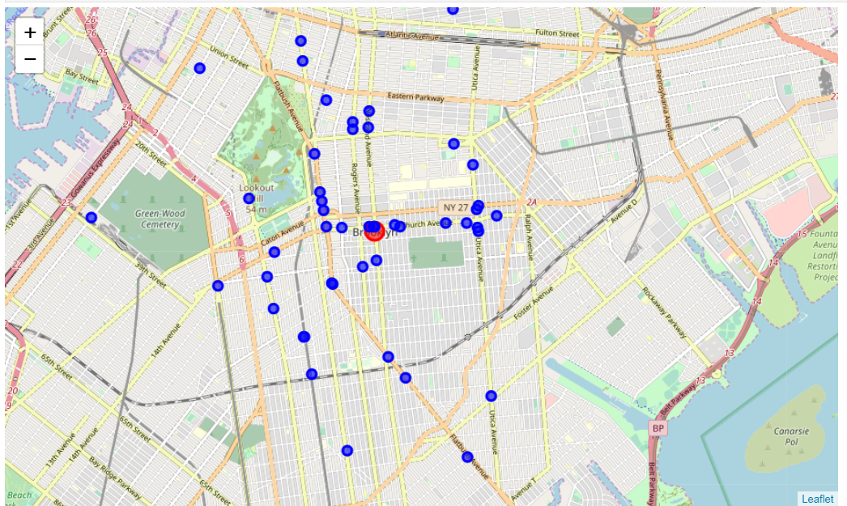
Brooklyn Current Restaurants

Slide 8
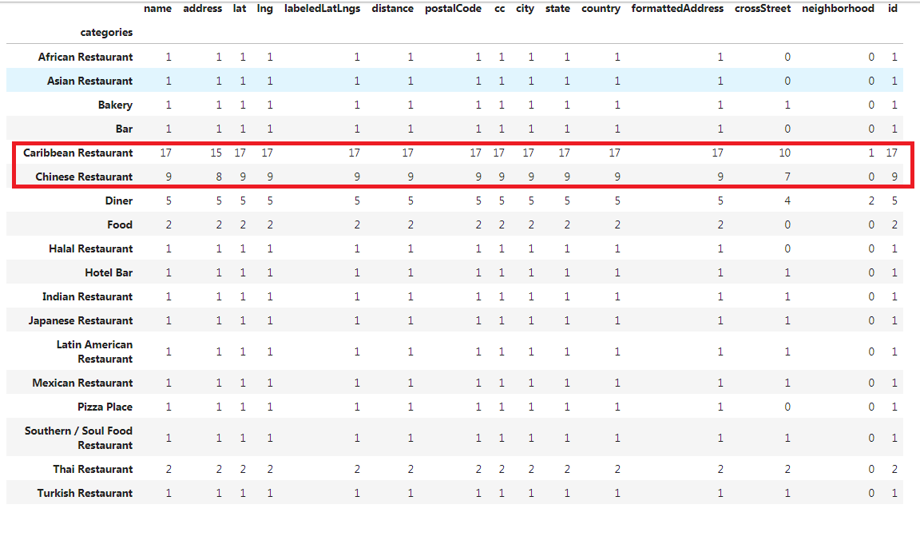
Brooklyn Restaurants Categories

Slide 9
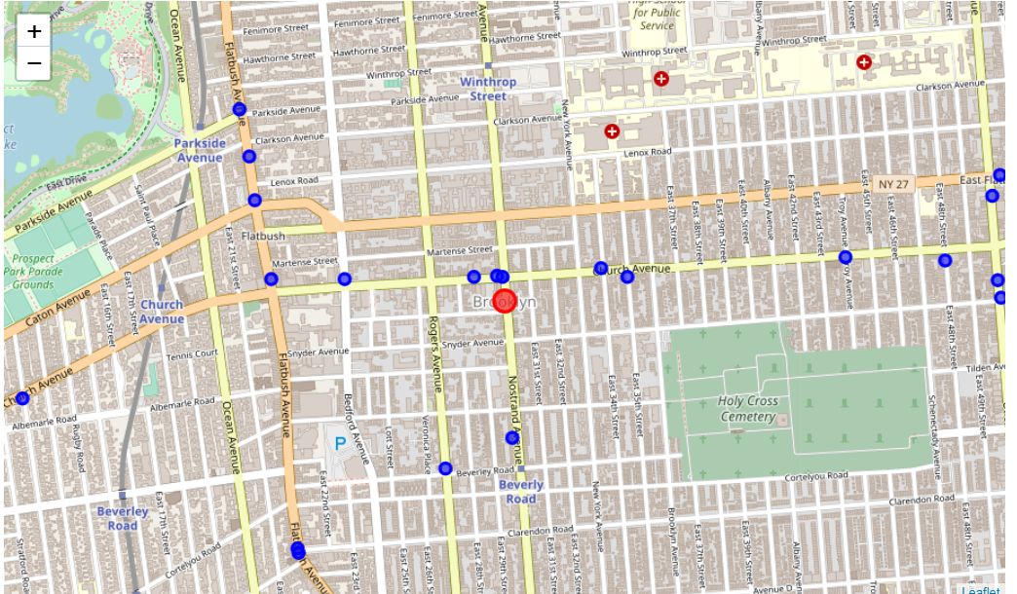
Brooklyn Restaurant Trending

Slide 10
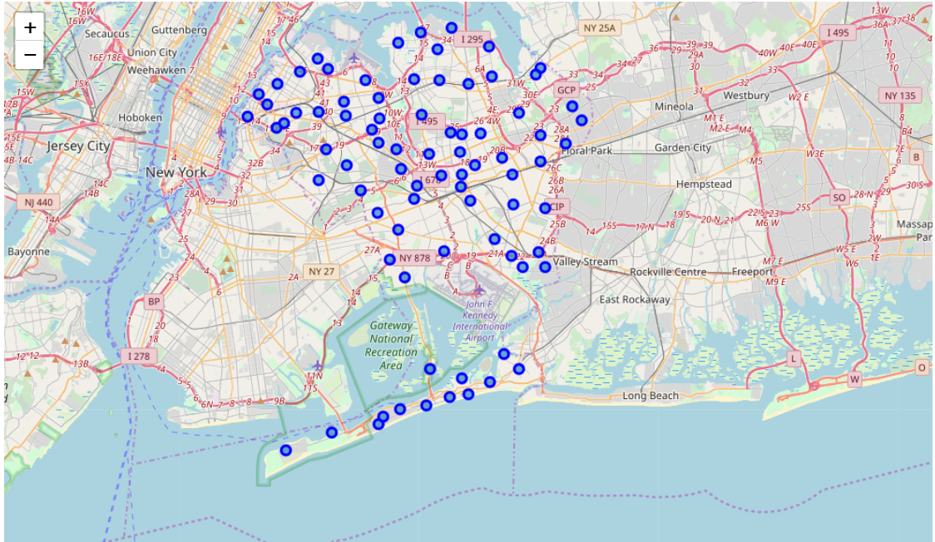
Queens Neighborhoods

Slide 11
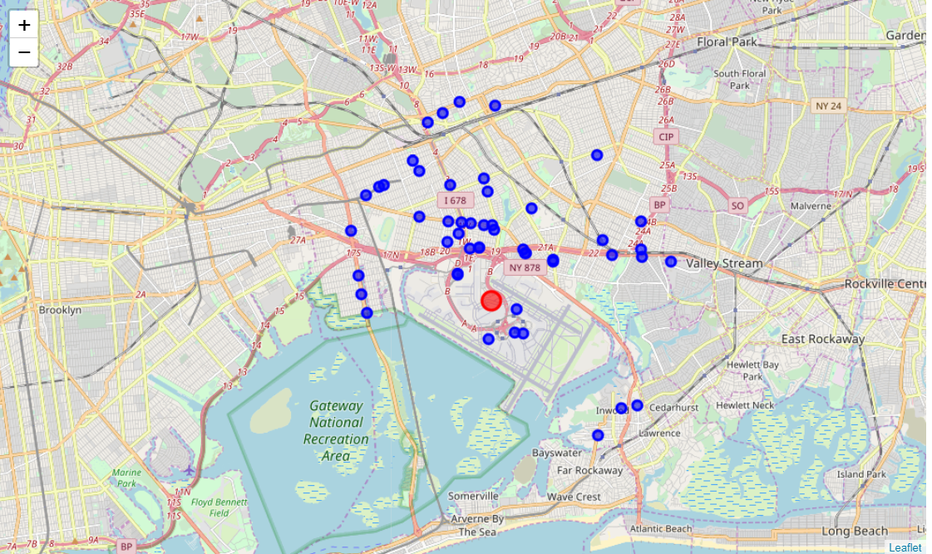
Queens Current Restaurants

Slide 12
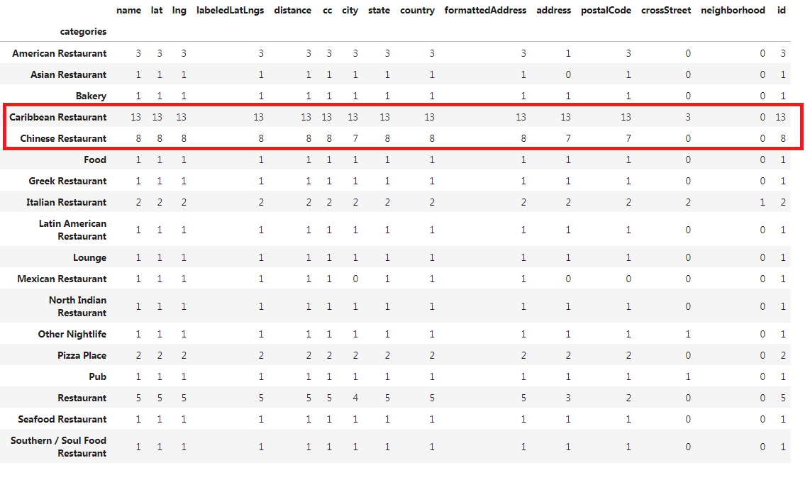
Queens Restaurants Categories

Slide 13
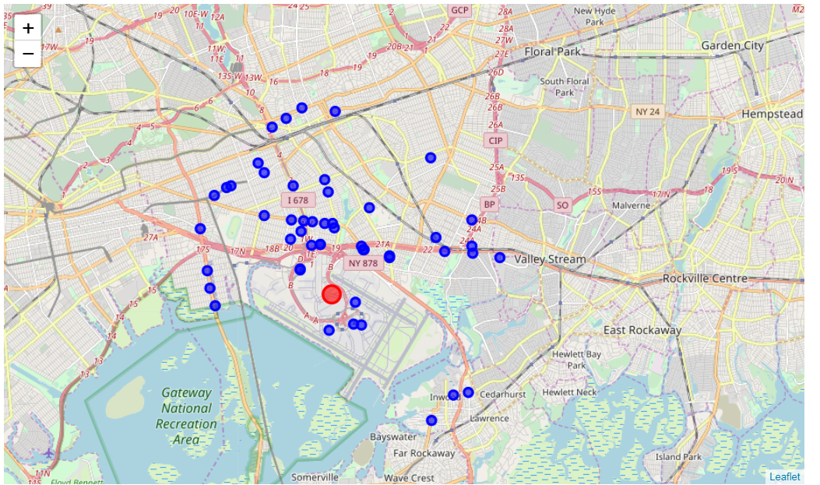
Queens Restaurants Trending

Slide 14
Comparison: Brooklyn VS. Queens
Neighborhoods Distribution: Brooklyn is more evenly
Current Restaurants: Both similar types and numbers
Trending: Brooklyn is more clear view
Summary: Brooklyn will be the place to choose

Slide 15
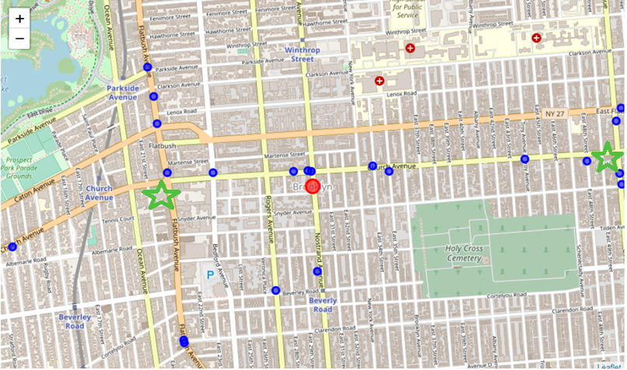
2 Possible Locations

